Slide 1
Mood, Tone, and Style
How authors spice it up!!!

Slide 2
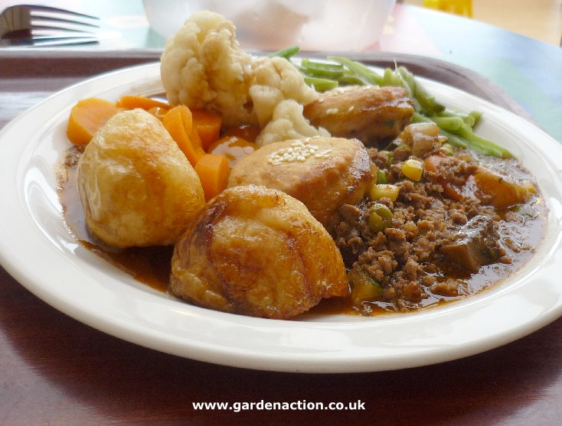
Mood, Tone, and Style
Think of a story as a homemade meal. The basic ingredients – plot, characters, setting, and theme – need some spice, a unique flavor.
Authors can add this flavor by creating certain moods and by using a certain attitude or tone to deliver the message.

Slide 3
Mood, Tone, and Style
Mood is a feeling that a writer creates for readers.
To identify mood, think about how you feel as you read.
Pay close attention to adjectives used to describe the setting and characters’ behaviors and thoughts.

Slide 4
Mood, Tone, and Style
Just a few words to describe mood:
wondrous
eerie
terrifying
peaceful
silly
cheerful
romantic
somber
thoughtful

Slide 5
Mood, Tone, and Style
A wind had sprung up, driving the dust of the weeks-dry road before it, when they entered the street on which they lived, and the leaves rustled ominously. Lightning flickered.
From “Rain, Rain, Go Away” by Isaac Asimov

Slide 6
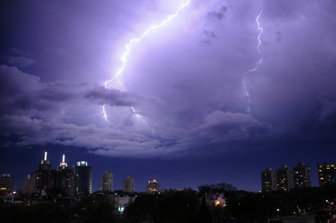
Mood, Tone, and Style
Did the highlighted words and phrases reveal a gloomy setting?
Did they create an eerie mood?
Does this picture create a spooky feeling?

Slide 7
Mood, Tone, and Style
Now, read the excerpt from The Witch of Blackbird Pond, a novel by Elizabeth George Speare. You will find it on page 439.
Find two details that the writer uses to describe the setting.
Find two details that tell you how Kit feels about her surroundings.
How would you describe the mood of this excerpt?

Slide 8
Mood, Tone, and Style
Tone is a writer’s attitude toward his or her subject.
The topic and the audience often demands a certain tone.

Slide 9
Mood, Tone, and Style
Words to describe tone:
humorous
sarcastic
sympathetic
serious
sincere
mocking
disgusted
admiring
angry

Slide 10
Mood, Tone, and Style
I went to a British school, and every morning we sang “God Save the King.” Of course, the British children loved singing about their gracious king. Ian Forbes stuck out his chest and sang as if he were saving the kind all by himself.
From Homesick by Jean Fritz

Slide 11
Mood, Tone, and Style
Did the highlighted words and phrases help you “hear” the author’s mocking tone?
Did you read “gracious” with sort of a snotty attitude?

Slide 12
Mood, Tone, and Style
Now, read the excerpt from Boy: Tales of Childhood, an autobiography by Roald Dahl. You will find this excerpt on p.439.
As you read, look for words that have negative connotations (or feelings) attached to them.
How would you describe Dahl’s tone (or his attitude) toward Mrs. Pratchett?

Slide 13
Mood, Tone, and Style
Consider this scenario:
One time my kids and I were playing Mario Cart on the WII. Every time my character nearly crashed or fell off a bridge, I screamed. I was scared to pieces. In fact, I was so nervous and tense that I told them that we had to quit playing. My son, after casting me a questioning look, said, “Mom, this is about as scary as a walk in the park – in daylight – on a sunny day – with your grandma.”
So, my mood was ________________________?
His tone was ____________________________?

Slide 14
Mood, Tone, and Style
Now, read the excerpt from One Ordinary Day, with Peanuts (p. 442), by Shirley Jackson.
You and your partner should make note of words and details in lines 1-7 that help create a cheerful mood.
Look at the boxed details; would you describe the author’s tone, or attitude, toward Mr. Johnson as mocking or admiring?

Slide 15
Mood, Tone, and Style
Now read the excerpt from “Rip Van Winkle,” a short story by Washington Irving (p. 443). HINT: be sure to read the information above the excerpt.
Look at the details in the boxes. What mood do they help to create?
Read lines 3-8 (using your read-out-loud teacher voice so that you can “hear” the attitude). Is the author’s tone serious or mocking?

