Slide 1
Reading Tips to Remember
Each ACT passage should be read in approximately three minutes, with pencil for annotation, and with two reading speeds.

Slide 2
Reading Tips to Remember
You are reading the passages rather quickly so that you can bank enough time to answer the questions.
Basically, you want to spend under 9 minutes per passage (three for reading the passage itself; six for answering the questions).
Points are earned for answering questions correctly, not for reading the passage.

Slide 3
Reading Tips to Remember
Do not read the passage like a race car driver just trying to cross the finish line!

Slide 4
Reading Tips to Remember
Smart race car drivers take pit stops occasionally – to make sure they can finish the race.

Slide 5
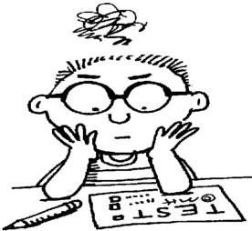
Reading Tips to Remember
Smart ACT test-takers and readers make regular pit stops – to make sure they are engaged with what they are reading.
Smart ACT test-takers and readers make sure they read with their pencil in their hand.

Slide 6
Reading Tips to Remember
You should have two basic reading speeds.
One that is pretty darned fast.
One that is even faster.
Use your pretty darned fast speed at the beginning of the passage (to find out the overall topic, purpose, tone, tense, etc.)
Use your even faster speed to read through and annotate the supporting details.

Slide 7
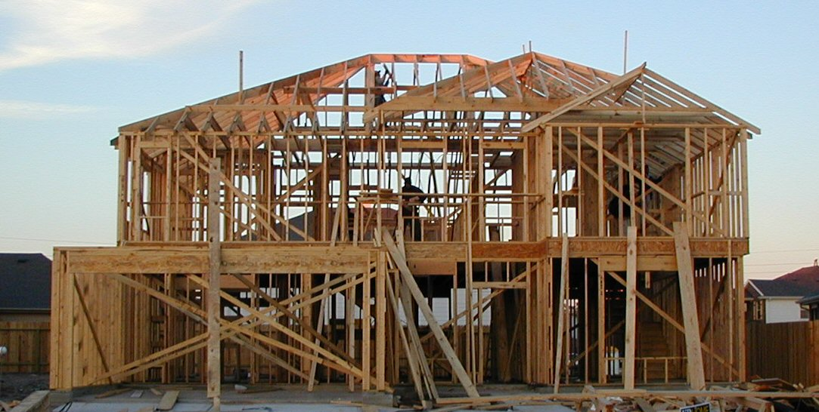
Reading Tips to Remember
Once you know the main idea of each paragraph, feel free to speed up through the rest of that paragraph. Quite often the main idea is stated at the beginning of the paragraph – but not always!
One helpful hint is to decide what the supporting details are proving, illustrating, or explaining.
Think of the main idea as the roof; the supporting details help hold it up.

Slide 8
Reading Tips to Remember
For the fiction passages, make sure you know who the main characters are and how they relate to each other.
In your head, make sure you can complete a Character/Wants to/But/So chart. If you’re not familiar with this chart, I’ll fill you in on it later.
Ask yourself what the main character learned; that is probably what the author wants you to learn, too.

Slide 9
Reading Tips to Remember
For the non-fiction passages (the other three), make sure you know the main point the speaker is making.
Make sure you’ve noticed how he or she demonstrated that point (in other words, how is the passage structured).
Sometimes it is helpful to ask yourself what are two or three arguments for or against the topic.

Slide 10
Reading Tips to Remember
Let’s Go! Try the quiz over “Home” and “Henna Body Painting”
These are not typical ACT passages, but they will help us identify our next best step!!

