Slide 1
Using the Right Word

Slide 2
Using the Right Word
Affect vs. effect
Affect = A ferb
It means “to influence.”
Effect = Result
Sometimes “effect” can be used as a verb if it means “to bring about; to produce; to accomplish; to complete.”

Slide 3
Using the Right Word
Among vs. between
Among has a gang of things around it.
Between almost has the word “two” in the middle of it.
Between is also used when a specific list of items, people, etc., are being compared.

Slide 4
Using the Right Word
Continual vs. continuous
Something that is continual HAS some interruptions or breaks, but something that is continuous does NOT HAVE breaks.
The continual revisions that software undergoes makes it hard to keep up with the latest versions. There are some breaks in between software updates.
The continuous tinkling of the chimes was an indicator of the wind’s staying power that stormy afternoon. That stormy afternoon, there were no breaks in the tinkling of the chimes.

Slide 5
Using the Right Word
Different from vs. different than
Jones Longhorns differ from Harrah Panthers because the Longhorns are just better. It doesn’t sound right to say that the Longhorns differ than the Panthers, right? So “different” and “from” go together.
Jones Longhorns are different from the Harrah Panthers because the Longhorns are better.
If I am comparing two things, like the Longhorns and the Panthers, I need to use different from.
The only time I use different than is if I have a dependent clause (subject/verb combination) after it.
Life is different than it used to be. (Notice that “it” is the subject and “used” is the verb of this dependent clause.)

Slide 6
Using the Right Word
Healthful vs. healthy
Healthful refers to something that makes one full of health. In other words, things that can be described as healthful (things that make you full of health) might be nutritious foods or an active lifestyle or an exercise routine.
After eating healthful foods, etc., you possess HEALTH – therefore, you are HEALTHY.
Healthful describes things; healthy describes people.

Slide 7
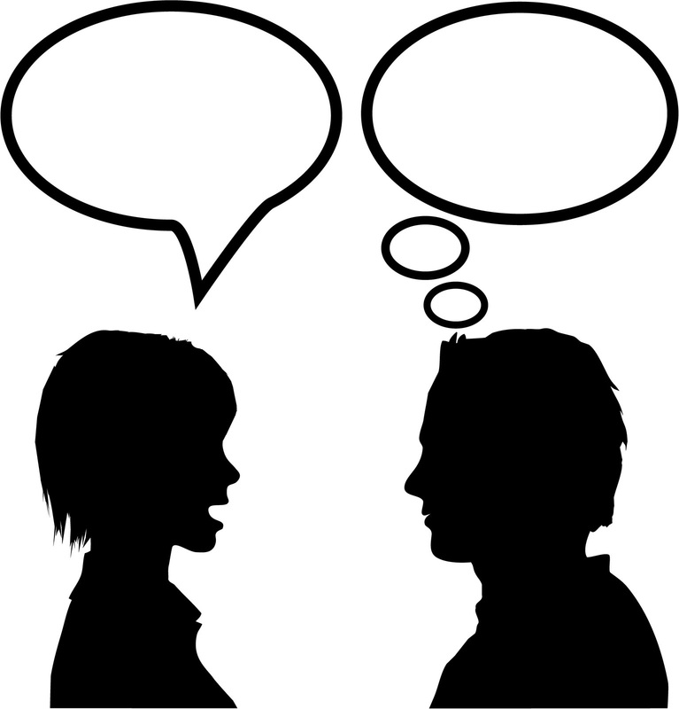
Using the Right Word
Imply vs. infer
So, in this picture, who
is doing the speaking
(the implying)?
Who is having to interpret (inFERpret)?

Slide 8
Using the Right Word
Lay vs. lie
Lay is a transitive verb that means to place. In other words, you are placing something somewhere.
Lie is an intransitive verb that means to recline.
Look at this first line of a famous childhood prayer:
Now I lay me down to sleep.
This children’s prayer could read:
Now I place me down to lie.

Slide 9
Using the Right Word
Infinitive | Definition | Simple Present | Simple Past | Past Participle | Present Participle
to lay | to put something down | lay(s) | laid | laid | laying
to lie | to rest or recline | lie(s) | lay | lain | lying

Slide 10
Using the Right Word
Ensure vs. insure
“En” as a prefix means “to make into or to make like.” So, to ensure is to make something be certain or sure.
This is easier:
Insure suggests that money is involved – to cover the value of something.
$nsure

Slide 11
Using the Right Word
Like vs. as
Like is a verb or a preposition. It introduces prepositional phrases.
I like the dog. I look like an old hag.
As, on the other hand, is a subordinating conjunction and introduces clauses. Clauses are groups of words that contain a subject and its verb.
I am certain the cheerleaders will do well, as they have worked and practiced hard for a long time.

